Slide 1
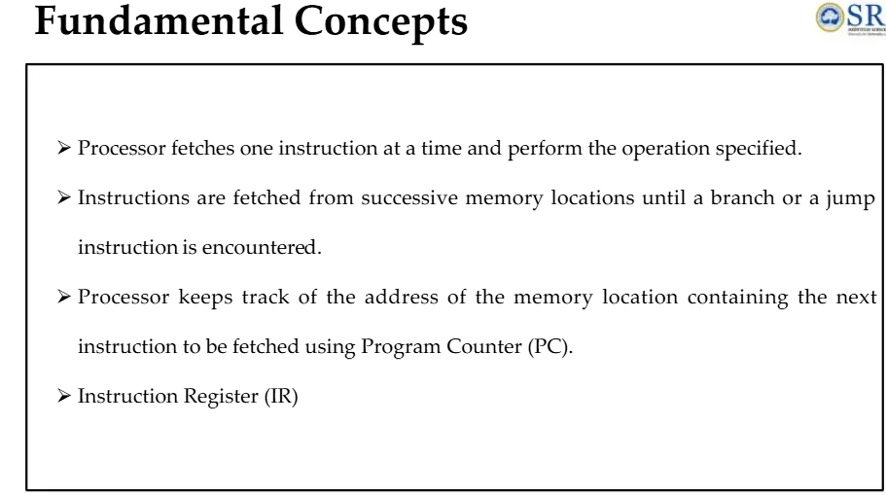

Slide 2
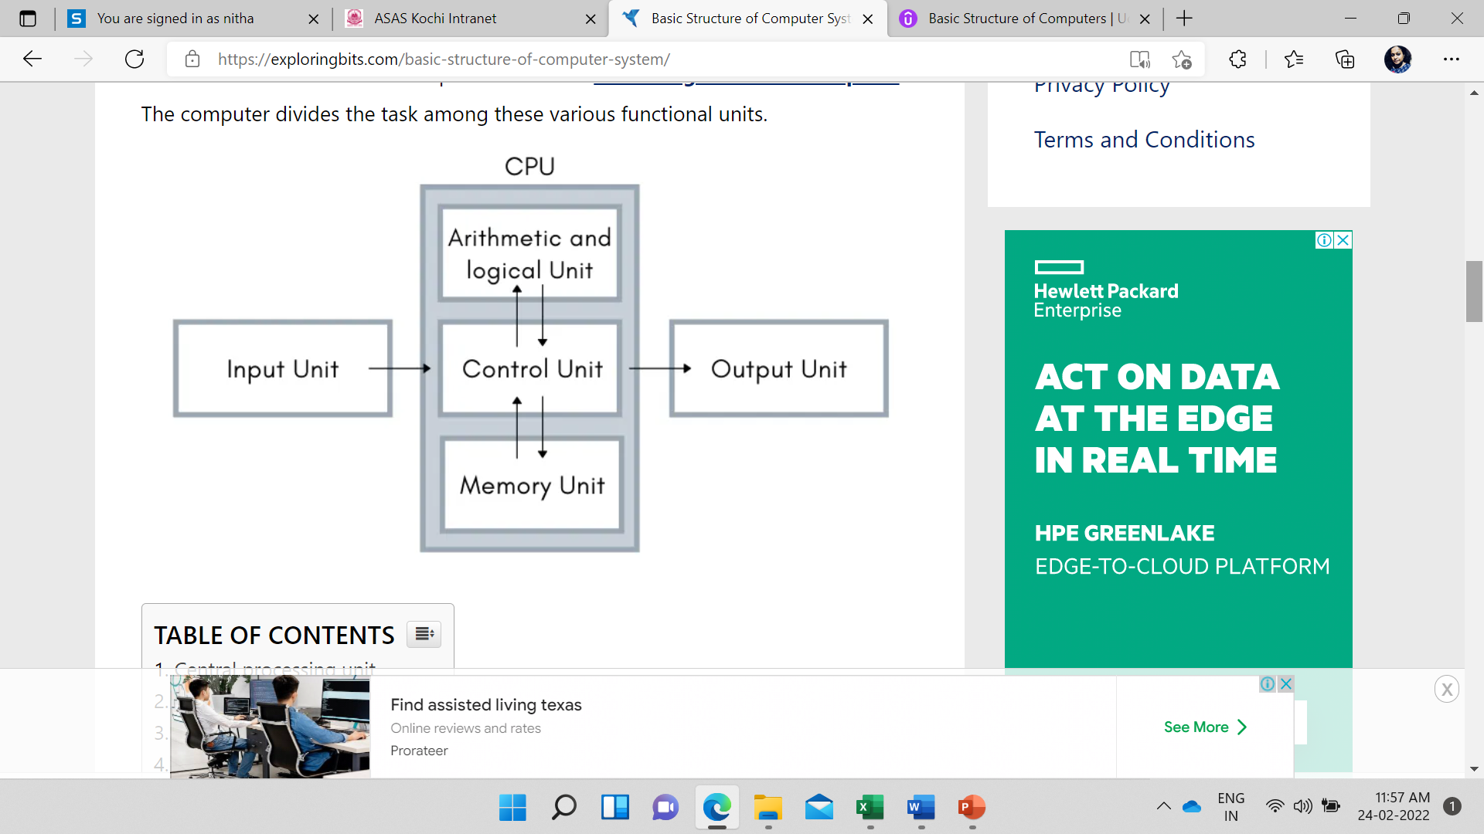
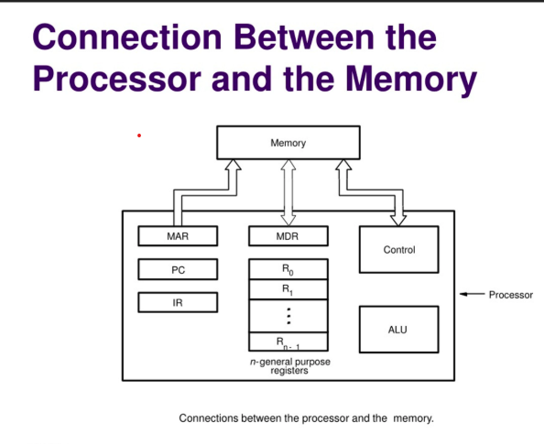

Slide 3
FUNDAMENTAL CONCEPTS
UNIT 2

Slide 4
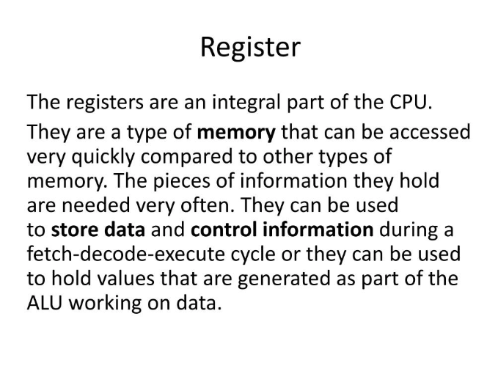
SOME OF THE REGISTERS
Program Counter (PC)
Instruction Register (IR)
Memory Address Register (MAR)
Memory Data Register (MDR)
General Purpose Registers

Slide 5
General Purpose Registers
A register is a collection of flip-flops. Single bit digital data is stored using flip-flops. By combining many flip-flops, the storage capacity can be extended to accommodate a huge number of bits. We must utilize an n-bit register with n flip flops if we wish to store an n-bit word.
General Purpose Registers (GPRs) are essential components within a CPU, serving as temporary storage locations for data that is actively being processed. Unlike special-purpose registers, which are dedicated to specific tasks, GPRs are versatile and can store a wide variety of data, including operands for arithmetic and logic operations, memory addresses, or intermediate results.

Slide 6
They provide fast access to frequently used data, reducing the need to fetch from slower main memory and thereby speeding up program execution. Their contents can be read/written by programmer /user through instructions.

Slide 7
PROGRAM COUNTER
The program counter, also known as the instruction pointer or simply PC, is a fundamental component of a computer's central processing unit (CPU). It is a special register that keeps track of the memory address of the next instruction to be executed in a program.

Slide 8
INSTRUCTION REGISTER
The Instruction Register (IR) is a crucial component of a computer's Central Processing Unit (CPU). It holds the instruction currently being executed or decoded. The IR is part of the control unit of the CPU and plays a vital role in the instruction cycle, which includes fetching, decoding, and executing instructions.

Slide 9
Function and Workflow
The instruction register temporarily stores the instruction fetched from memory. This instruction is then decoded to determine the operation to be performed and the operands involved. The decoded instruction is executed by the CPU, and the results are stored back in memory or other registers.

Slide 10
Step-by-Step Process
Fetch Phase: The CPU fetches the next instruction from memory and loads it into the instruction register. This step ensures that the CPU knows what operation to execute next.
Decode Phase: The instruction in the IR is decoded to interpret the command. This involves determining the operation and the operands.
Execute Phase: The decoded instruction is executed. For example, an addition operation would add the contents of two registers and store the result in a third register.

Slide 11
Memory Address Register (MAR)
The Memory Address Register (MAR) is a crucial component within a computer's CPU. It is responsible for storing the memory address from which data will be fetched to the CPU registers or the address to which data will be sent and stored via the system bus. Essentially, the MAR holds the memory location of data that needs to be accessed during the execution phase of an instruction.

Slide 12
Key Functions of MAR
Fetching Data: When the CPU needs to read data from memory, the MAR holds the address of the data to be fetched.
Storing Data: When the CPU needs to write data to memory, the MAR holds the address where the data will be stored.
Coordination with MDR: The MAR works in conjunction with the Memory Data Register (MDR) to facilitate the transfer of data between the CPU and memory.

Slide 13
Memory Data Register (MDR)
The Memory Data Register (MDR) The Memory Data Register (MDR) is a crucial component in CPU architecture, serving as a buffer for data during transfer to and from main memory. It works with the Memory Address Register (MAR) to facilitate read and write operations, influencing the speed and efficiency of data processing.

Slide 14
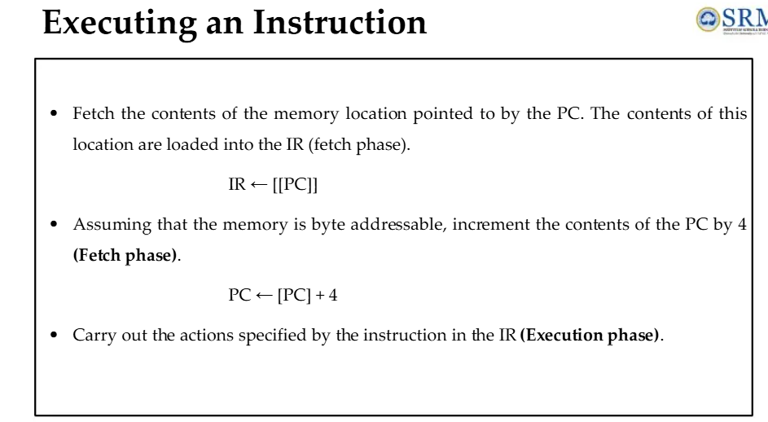

Slide 15
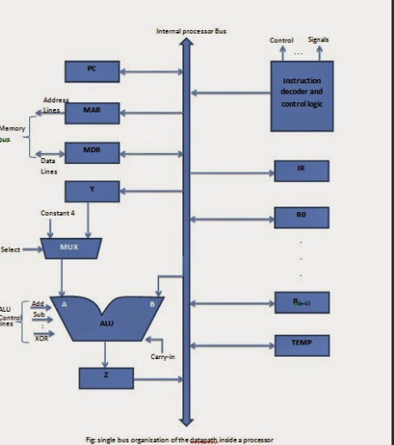
SINGLE BUS ORGANISATION

Slide 16
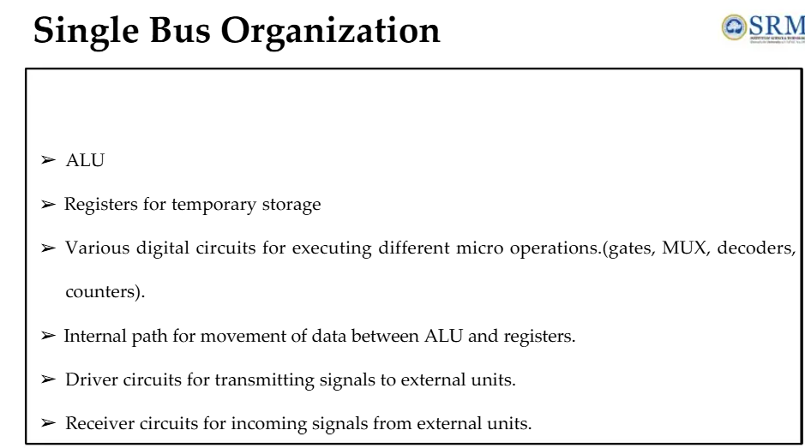

Slide 17
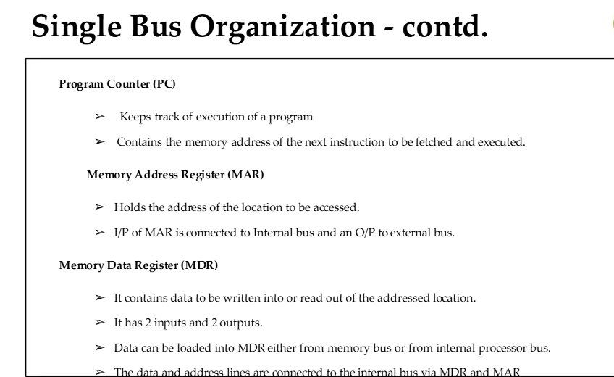

Slide 18
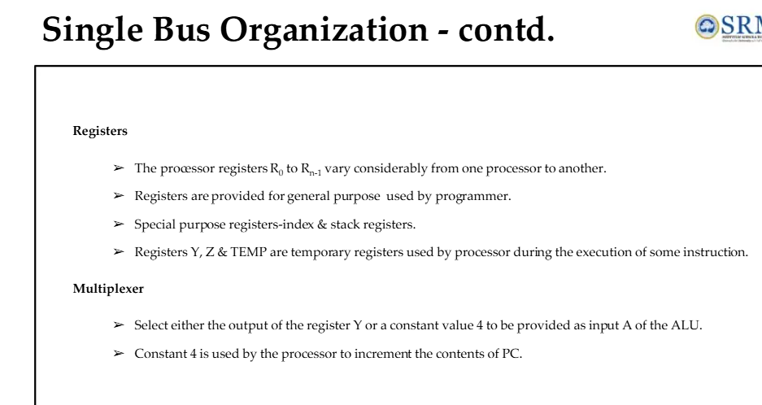

Slide 19
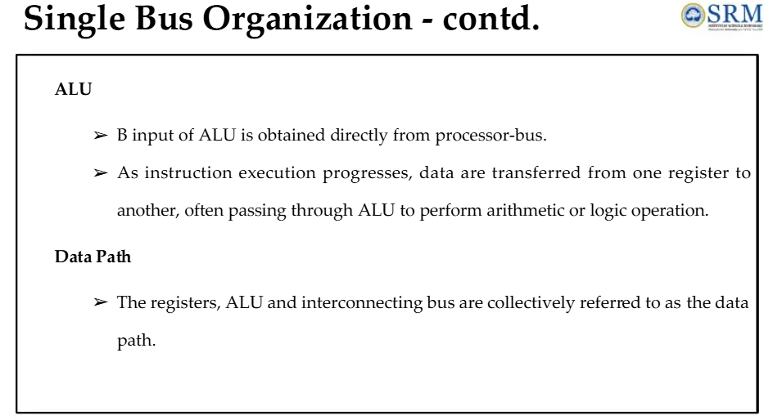

Slide 20
DATA PATH
A data path (or datapath) is a critical component of a computer's architecture, consisting of various functional units such as:
Arithmetic Logic Units (ALUs): Perform arithmetic and logical operations.
Registers: Temporary storage locations for data being processed.
Buses:Communication pathways that transfer data between components within the CPU.

Slide 21
An Instruction Can Be Executed By Performing One Or More Of The Following Operations
Transfer a word of data from one processor register to another or to the ALU
Perform an arithmetic or a logic operation and store the result in a processor register
Fetch the contents of given memory location and load them into processor register
Store a word of data from a processor register into a given memory location

Slide 22
An Instruction code is a group of bits that instructs the computer to perform a specific operation.
It is divided into two parts and the most important parts of an instruction code is its operation code or opcode. The second part is the address part which specifies the memory address.

Slide 23
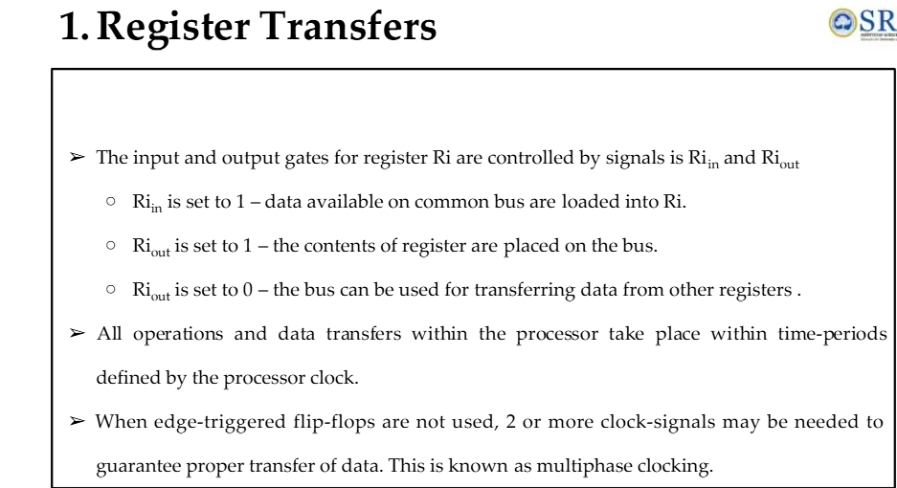

Slide 24
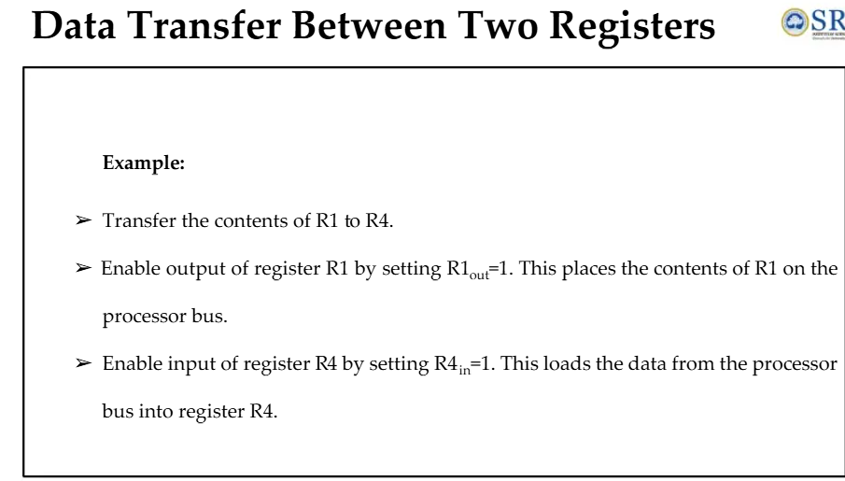

Slide 25
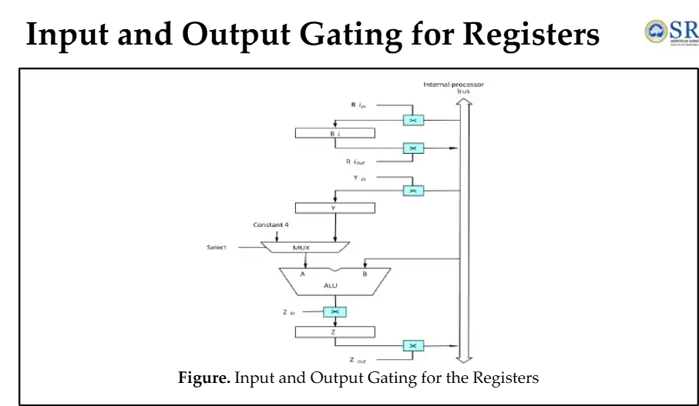

Slide 26
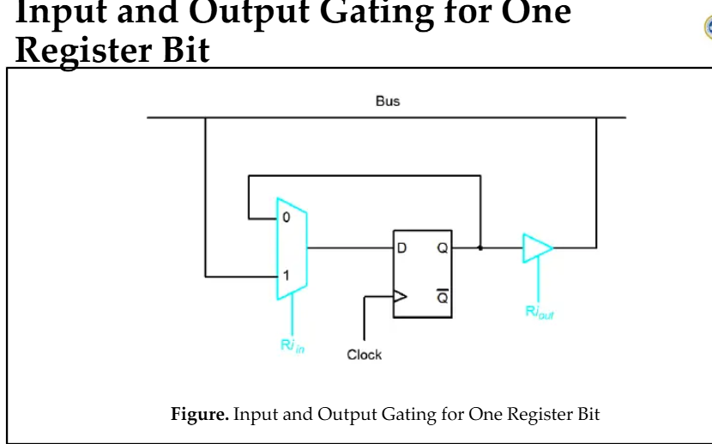

Slide 27
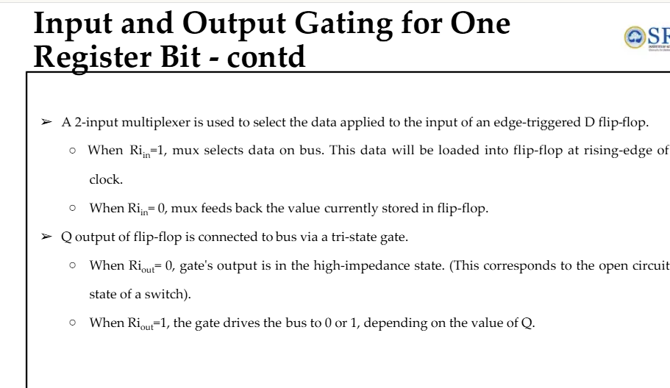

Slide 30
Memory
35
1
ADD
300
300
1350
1350
Operand

Slide 31
One bit of instruction code can be used to distinguish between a direct and indirect address. This configuration is shown below:

Slide 32
An indirect address instruction is shown below:

Slide 33
The indirect address instruction needs two references to memory to fetch an operand.
The first reference is needed to read the address of the operand; (i e to fetch the effective address)
And second is for the operand itself. (i.e. to read or write the actual operand. )
EA=ADDRESS OF THE OPERAND

Slide 34
Memory
Memory
22
0
ADD
457
1
ADD
300
35
457
Operand
300
1350
1350
Operand
+
+
b) Indirect address
AC
AC

Slide 35
The instruction in address 35 is shown in fig. above has a mode bit I = 1.
Therefore, it is recognized as an indirect address instruction.
The address part is the binary equivalent of 300.

Slide 36
The control goes to address 300 to find the address of the operand.
The address of the operand in this case is 1350.
If the operand is found in address 1350, then it is added to the content of AC.

Slide 37
Computer Instructions
The basic computer has three instruction code formats as shown below:
Memory-Reference Instructions
Register-Reference Instructions
Input-Output Instructions

Slide 38
1. Memory-reference instruction
A memory-reference instruction uses 12 bits to specify an address and one bit to specify the addressing mode I.
I is equal to 0 for direct address and 1 for indirect address
15
14
12
11
0
I
Opcode
Address
(Opcode is=000 through 110)

Slide 39
Example1:- AND 0122
Example2:- AND 0122
AND 0 122
0 000 0001 0010 0010
AND 1 122
1 000 0001 0010 0010
I(Direct Addr)
opcode
Memory addrs
I(Direct Addr)
opcode
Memory addrs
Hexadecimal Code
SYMBOL I = 0 I = 1 DESCRIPTION
AND 0xxx 8xxx AND memory word to AC
ADD 1xxx 9xxx Add memory word to AC
LDA 2xxx Axxx Load memory word to AC
STA 3xxx Bxxx Store content of AC in memory
BUN 4xxx Cxxx Branch unconditionally
BSA 5xxx Dxxx Branch and Save return address
ISZ 6xxx Exxx Increment and skip if zero.

Slide 40
The hexadecimal code is equal to the equivalent hexadecimal number of the binary code used for the instruction.
By using the hexadecimal equivalent we reduce the 16 bit of an instruction code to four digit with each hexadecimal digits being equal to four bits.

Slide 41
When I = 0, the last four bits of an instruction have a hexadecimal digit equivalent from 0 to 6 since the last bit is 0.
[ 0xxx – 6xxx i.e. 0000 x x x – 0110 x x x. So the last bit is zero.] So it’s a direct memory-reference instruction.

Slide 42
When I = 1, the hexadecimal digit equivalent of the last four bits of the instruction ranges from 8xxx to Exxx since the last bit is 1.
[ 8xxx – Exxx i.e. 1000 x x x – 1110 x x x. So the last bit is one.] So it’s an indirect memory-reference instruction.

Slide 43
2. Register-reference instruction
A register-reference instruction are recognized by the opcode 111 with a 0 in the leftmost bit (bit 15) of the instruction.

Slide 44
A register-reference instruction specifies an operation on or a test on the AC register.
15
14
12
11
0
0
111
Register operation
(Opcode is = 111, I = 0)

Slide 45
An operand from memory is not needed and therefore the other 12 bits are used to specify the operation or test to be executed on registers.

Slide 46
7800
0111 1000 0000 0000
Example:-
SYMBOL Hexadecimal Code DESCRIPTION
CLA 7800 Clear AC
CLE 7400 Clear E
CMA 7200 Complement AC
CIR 7080 Circulate right AC and E
INC 7020 Increment AC
HLT 7001 Halt computer

Slide 47
Register reference instructions use 16 bits to specify an operation.
The left most bit is always 0111, which is equal hexadecimal 7.
The other three hexadecimal digits give the binary equivalent of the remaining 12 bits.

Slide 48
3. Input - output instruction
An input-output instruction does not need a reference to memory and is recognized by the operation code 111 with a 1 in the left most bit of the instruction.

Slide 49
The remaining 12 bits are used to specify the type of input-output operation or test to be performed.
15
14
12
11
0
1
111
I/O operation
(Opcode is = 111, I = 1)

Slide 50
The input-output instructions also use all 16 bits to specify an operation .
The last four bits are always 1111, equivalent to hexadecimal F.

Slide 51
The type of instruction is recognized by the computer from the four bits in positions 12 through 15 of the instruction.

Slide 52
If the three opcode bits in positions 12 through 14 are not equal to 111, the instruction is a memory-reference type and the bit in position 15 is taken as the addressing mode I.

Slide 53
If the three bit opcode is equal to 111, control then inspects the bit in position 15.
If this bit is 0, then the instruction is a regiter-reference type.
If the bit is 1, the instruction is an input-output type.

Slide 54
SYMBOL Hexadecimal Code DESCRIPTION
INP F800 Input character to AC
OUT F400 Output character from AC
SKI F200 Skip on input Flag
SKO F100 Skip on output Flag
ION F080 Interrupt ON
IOF F040 Interrupt OFF

Slide 55
Instruction Cycle
A program residing in memory unit of the computer consist of a sequence of instructions.
The program is executed by going through a cycle for each instruction.

Slide 56
Each instruction cycle consist of the following phases:
Fetch an instruction from memory
Decode the instruction
Read the effective address from memory if the instruction has an indirect address.
Execute the instruction.

Slide 57
Control Unit of a basic Computer
The block diagram of a control unit is shown below.
It consist of two decoders (3x8 and 4x16), a sequence counter (SC), and a number of control logic gates.

Slide 58
Instruction Register (IR)
Fig-1 Control Unit
of Basic Computer
15
14
13
12
11 - 0
Other inputs
3 x 8
decoder
7
6
5
4
3
2
1
0
D₀
Control
logic
gates
Control outputs
I
D₇
T₁₅
T₀
15
14
2
1
0
4 x 16
decoder
4-bit
sequence
counter
Increment (INR)
Clear (CLR)
Clock

Slide 59
Upon the completion of step 4, the control goes back to step 1 to fetch, decode, and execute the next instruction.
This process continues indefinitely unless a HALT instruction is encountered.

Slide 60
Fetch and Decode
Initially, the program counter is loaded with the address of the first instruction in the program.
The sequence counter SC is cleared to 0, providing a decoding timing signal T₀.

Slide 61
After each clock pulse, SC is incremented by one, so that the timing signals go through a sequence T₀,T₁,T₂ and so on.

Slide 62
The microoperations for the fetch and decode phases can be specified by the following register transfer statements.
T₀: AR ← PC
T₁: IR ← M[AR], PC ←PC+1
T₂: D0, … D7←Decode IR(12-14), AR←IR(0-11), I ← IR(15)

Slide 63
To provide the data path for the transfer of PC to AR the following signals are required.
Place the content of PC onto the bus by making the bus selection inputs S₂S₁S₀ = 010.
Transfer the content of the bus to AR by enabling the LD input of AR.

Slide 64
S₂
BUS
S₁
T0: AR←PC
S₀
Memory Unit
4096 x 16
7
Address
Write
Read
AR
1
LD
INR
CLR
PC
2
LD
INR
CLR
IR
5
LD
Clock
16-bit common bus

Slide 65
In order to implement the second statement
(Read) T₁:IR ← M[AR], PC ←PC+1
It is necessary to use the timing signal T1 to provide the following connections in the bus system.

Slide 66
Enable the read input of memory
Place the content of memory onto the bus by making S₂S₁S₀ = 111.
Transfer the content of the bus to IR by enabling the LD input of IR.
Increment PC by enabling the INR input of PC.
T₁:IR ← M[AR], PC ←PC+1

Slide 67
(Read) T1:IR ← M[AR], PC ←PC+1
S₂
BUS
S₁
S₀
Memory Unit
4096 x 16
7
Address
Write
Read
AR
1
LD
INR
CLR
PC
2
LD
INR
CLR
IR
5
LD
Clock
16-bit common bus

Slide 68
Start
SC ← 0
T₀
Flow chart for
instruction cycle
AR ← PC
T₁
IR ← M[AR], PC ← PC+1
T₂
Decode opcode in IR(12-14)
AR ← IR(0-11), I ← IR(15)
(Register or I/O) = 1
D₇
= 0 (Memory –reference)
(I/O) = 1
= 0 (register)
(indirect) = 1
= 0 (direct)
I
I
T₃
T₃
T₃
T₃
AR ← M[AR]
Nothing
Execute
I/O
Instructions
SC ← 0
Execute
Register-reference
Instructions
SC ← 0
Execute
Memory –reference
Instructions
SC ← 0

Slide 69
Determine the type of Instruction
The timing signal that is active after the decoding is T₃.
During T3, the CU determines the type of instruction that was read from the memory.
The flow chart above shows how the control determines the instruction type after decoding.

Slide 70
The decoder output D₇ is equal to 1, if the opcode is equal to the binary 111.
If D₇ = 1, the instruction must be register-reference or I/O type.
If D₇ = 0, the instruction is recognized as a memory –reference instruction.

Slide 71
Control then inspects the value of the first bit of instruction, which is available in flip-flop I.
If D₇ = 0 and I = 1, its an indirect memory reference.
It is then necessary to read the effective address from the memory.

Slide 72
The microoperation for the indirect address condition in register transfer statement is as follows:
AR ← M[AR]
Initially AR holds the address part of the instruction.
This address is used during the memory read operation.

Slide 73
The word at address given by AR i.e. M[AR] is read from memory and placed on the common bus
The LD input of AR is then enabled to receive the indirect address that resided in the 12 least significant bits of the memory word.

Slide 74
END

Slide 75
REGISTER TRANSFERS
In computer architecture, register transfer refers to the process of copying data between registers, which are small, fast storage locations within the CPU.
It involves the use of a register transfer language (RTL), a symbolic notation for describing these data movements and the micro-operations (like addition or shift) performed on the data.

Slide 76
A register transfer statement, such as R1 -> R2, indicates that the contents of register R1 are copied into R2. This action requires control signals to execute and data lines to facilitate the simultaneous, parallel transfer of bits during a single clock pulse, without altering the source register.

Slide 77
Key Concepts
Registers:
Small, high-speed storage units within a processor used to hold data for immediate processing.
Micro-operations:
The basic operations performed on the data stored in registers, such as data transfer, addition, subtraction, or shifting.
Register Transfer Language (RTL):
A symbolic language used to describe the micro-operations and the flow of data between registers in a digital system.
Control Functions:
Control signals that initiate or allow a register transfer to occur only when a specific condition is met (e.g., P: R1 -> R2 only happens when control signal P is 1).

Slide 78
How Register Transfer Works?
\
Source and Destination:
A register transfer involves a source register (where data is read from) and a destination register (where data is written to).
Parallel Transfer:
All bits of data from the source register are copied to the destination register simultaneously during one clock pulse.
Non-Destructive:
The transfer is non-destructive, meaning the content of the source register remains unchanged after the data is copied.
Hardware Implementation:
Register transfers require specific hardware logic circuits, including data lines connecting the registers and control lines to manage the transfer process.
Control:
A control function or signal determines when the transfer takes place, allowing for conditional execution of operations.

Slide 79
Example
R2 ← R1: This RTL statement signifies that the data stored in register R1 is copied into register R2.
P: R1 → R2: This means that the contents of R1 are transferred to R2 only when the control signal P is active (P = 1).

